Slide 1

Stroke & Turn Level 1
British Columbia Summer Swimming Association
Officials Certification Program
Approved by the BCSSA Rules & Regulations Committee
May 2016

Slide 2

Welcome & thanks for attending!
Bill Bishop
  Director of Communications | Bill@WRASA.ca
Christine Kwan
  Director of Officials | Christine@WRASA.ca
Approved by the BCSSA Rules & Regulations Committee

Slide 3
WRASA Officials
always lots of WRASA white shirts on deck
always promoting – need senior officials
always supporting – encouraging new officials
always available – shadow, questions, help
Approved by the BCSSA Rules & Regulations Committee

Slide 4

Approved by the BCSSA Rules & Regulations Committee

Slide 5
Your first step in Officiating

Slide 6
Video: Officiating Intro
https://www.youtube.com/watch?v=78wXpbCuP2s&index=1&list=PLqeVqsXqy39hW9UhrsA3nCm3r55bLLcxk

Slide 7
BCSSA Officials Program

Slide 8





BCSSA Officials Levels
Level 1 – Junior Pin (Green)
    Lane Timer & Lane Recorder, Marshal & Understanding of Stroke and Turn
Level 2 – Intermediate Pin (Red)
    S&T, Recording Office, 2 of the following: Head Timer, Clerk of the Course or Electronics
Specialist Pin (Orange)
    Any of: Clerk of the Course, Hy-Tek, Meet Manager,
    Chief Meet Recorder or Electronics
Level 3 – Senior Pin (Light Blue)
    All Level 2 plus Starter, Referee, Meet Manager, DDO and CMR
Level 4 – Master Pin (Navy Blue)
    - Evaluated by the Provincial Dir. Of Officials & Written Exam
Approved by the BCSSA Rules & Regulations Committee

Slide 9
In this presentation
The Pool Deck
Officials on Deck
Stroke & Turn Judge
Your Presence on Deck
The Strokes
Disqualifcations
Wording
Resources for Officials
Contact Info

Slide 10
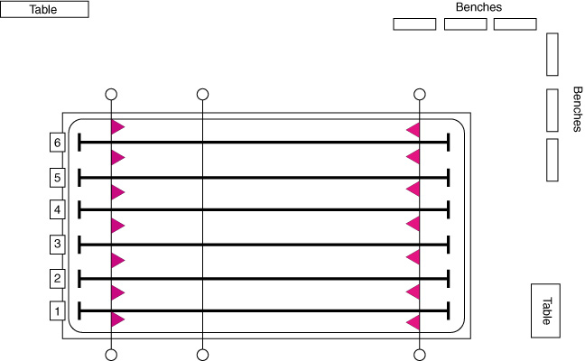
The Pool Deck
Number of lanes (6 – 8)
25m or 50m
Lane 1 is on the Right hand side from the Finish end
Working deck shall consist of those areas within 1.8m of the sides and turning end of the pool and within 4.5m of the Finish end

Slide 11

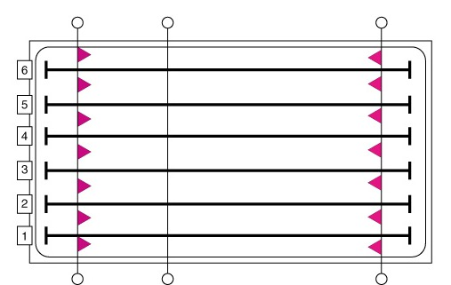
The Pool Deck
FLAGS
  5m
  20m
RECALL ROPE
  15m
CONES
  10m
  15m
measurements from the finish end

Slide 12
Meet the Officials

Slide 13
Meet the Officials
Meet Referee
Referee

Slide 14
Meet the Officials
Session Referee
Starter
Starter
Referee

Slide 15
Meet the Officials
DDO – designated disqualification official
Starter
Referee
DDO

Slide 16
Meet the Officials
Head Timer
Head Timer
Starter
Referee
DDO

Slide 17
Meet the Officials
Timers x2 per lane
Recorders x1 per lane
Head Timer
Timers
Recorders
Starter
Referee
DDO

Slide 18
Meet the Officials
Stroke Judges x2
Head Timer
Stroke Judge
Timers
Recorders
Referee
Starter
Stroke Judge
DDO

Slide 19
Meet the Officials
Turn Judges – turn end
3 per 6 lanes | 4 per 8 lanes
Head Timer
Stroke Judge
Timers
Turn Judges
Starter
Stroke Judge

Slide 20
Meet the Officials
Turn Judges – finish end
2 to 3 per 6 lanes | 3 to 4 per 8 lanes
Head Timer
Stroke Judge
Turn Judges
Turn Judges
Timers
Recorders
Starter
Stroke Judge

Slide 21
Meet the Officials
Clerk of the Course
Head Timer
Stroke Judge
Turn Judges
Clerk
Starter
Stroke Judge

Slide 22
Meet the Officials
Head Marshal
Marshals
Marshalling
Head Timer
Marshals
Stroke Judge
Timers
Turn Judges
Head Marshal
Clerk
Starter
Stroke Judge

Slide 23
Meet the Officials
Chief Judge Electronics
Marshalling
Chief Judge Electronics
Head Timer
Timers
Turn Judges
Clerk

Slide 24
Meet the Officials
CMR - Chief Meet Recorder
Chief Judge Electronics
CMR
Marshalling
Head Timer
Stroke Judge
Timers
Turn Judges
Clerk
Stroke Judge

Slide 25
Meet the Officials
a busy deck!
Electronics x2
CMR x2
Runners x2
Marshals x2
Head Marshal
Head Timer
Session Referee
Meet Referee
  40-50 officials
  are required to run a meet.
24 timers
& recorders
Turn Judges
Clerk
DDO
Stroke Judges x2
Turn Judges x8
Starter

Slide 26
Other Meet Day Volunteers
Runners x2
Deck Food – Prep & Runners x10
Marshalling – Marshals x4
Safety Marshal x1
Meet Office x4
Electronics x2
Announcer x1
Meet Manager x1
Concession, Raffle, Book Sale, Security, Sanitation, Awards, etc., etc.

Slide 27
Your Presence on Deck

Slide 28
What to bring on deck
Shifts last 2 hours and could be in the cold rain or the hot sun – be prepared
  light rain jacket
  wide brimmed hat
  sunglasses
  sunscreen
  wristwatch
  water bottle
  comfortable shoes
  reading glasses

Slide 29
Expectations of Officials
Dress Code
      White shirts
      White pants (shorts or pants)
      Comfortable, rubber soled shoes
      Expect to get wet
    Arrival Time
      Officials meeting (30 min between 6:30 and 7:30)
      Deck Shift - 10-15 min prior to the planned start time

Slide 30
Your Conduct on Deck
Have a positive attitude.
Accept an assignment only if you intend to honour the commitment.
Accept the assignment you have been given.
Don’t leave your post.
Complete the session.
Project absolute impartiality
Be inconspicuous.
Respect the Referee’s decision (it is final)
Remain cool and professional at all times
Be fair to all.
Be friendly, but don’t distract swimmers mentally preparing for a race.
READ THE RULE BOOK and know the rules!

Slide 31
Philosophy of Officiating
Swim Meets are for swimmers
Be as inconspicuous as possible.
      Avoid being militant or officious
      Lead by example
You will earn the respect of swimmers and coaches by being responsible, competent and knowledgeable.
You must continue to keep up with rule changes (attend a clinic each year to keep up to date).
Approved by the BCSSA Rules & Regulations Committee

Slide 32
Display Absolute Fairness
Rules and guidelines exist to regulate fair play, and to prevent the unfair advantage of one competitor over the other.
You are there to ensure fairness; no unfair advantage.
You are also there to provide learning and instruction to swimmers (the errors you point out are the areas the coach will focus on in future practices).
Always give the benefit of the doubt to the swimmer.
Approved by the BCSSA Rules & Regulations Committee

Slide 33
Be Fully Engaged
Pay attention, do your job (the swimmers take it seriously, so should you).
Ensure you are properly situated with no obstruction (e.g.: turn at edge of pool).
Be aware of stroke variations that are legal, as well as those that are illegal.
Always use common sense.
Be reasonable and certain of what you are doing.
If unsure, always consult the referee or other officials.

Slide 34
Always be Professional
Arrive before the meet starts in time for the Officials meeting.
Before the meet, the Meet Referee will establish the procedures to be followed for the meet.
Have your rulebook with you.
If you are going to make a DQ, ensure your position is covered.
  STROKE: Starter & Referee
  TURN: Increased coverage by turn judges

Slide 35
Insiders Tips
Rotations occur at the end of each page in the swim program, unless otherwise specified – be alert and prompt in rotations.
When responsible for the recall rope, ensure you know how to release it.
Take advantage of conflict resolution and harassment clinics when they are held in your region.
Be familiar with the Harassment Policy.

Slide 36
BCSSA Harassment Policy

Slide 37
BCSSA Harassment Policy
There will be no tolerance of harassment within the BC Summer Swimming Association.
The BC Summer Swimming Association is committed to providing a sport and work environment in which all individuals are treated with respect and dignity.
Each individual has the right to participate and work in an environment which promotes equal opportunities and prohibits discriminatory practices.
Approved by the BCSSA Rules & Regulations Committee

Slide 38

Level 1 Official

Slide 39
Level 1 Overview
Green Pin
– awarded by Club DO or Regional DO
Lane Timer & Recorder
Marshal
Beginner Stroke and Turn Judge

Slide 40
Lane Timer
Shall time the swimmer in the assigned lane from the starting signal to the ‘final touch.’
Shall take up a position over the finish end of the assigned lane.
Timers should remain seated when not engaged in timing the finish of a race or performing other assigned duties.
If manual timing, shall start the watch on seeing the flash of the starting signal, and shall stop it when the swimmer has completed the required distance and any part of the body touches the pad, the end wall, or crosses the vertical plane [imaginary] extending upward from the wall.
May act as the Relay Take-Over Judge and/or Turn Judge in the assigned lane, if so qualified and authorized by the Referee.

Slide 41
Lane Recorder
Ensure that the swimmer's name coincides with the swimmer on your heat sheet.
Ask the swimmers, "what is your name?" If you ask, "Is your name Johnny?" he may say yes, even though his name is Fred.
Ask the Timers for their initials and write them in the appropriate space on the heat sheet is manual timing.
As the Timers give you their times, write them on the time card opposite the appropriate initials.
Return your clipboard at the end of the session.
Shall determine if the swimmer has a light touch, and report this to the Chief Meet Recorder, by suitable notation on the time card.
Shall check for the correct swimmers in Relay[s].

Slide 42
Marshal
Report to the Clerk of the Course. Your duties may include:
  Keeping order in the marshalling area
  Arranging swimmers on deck
  Leading swimmer to the starting blocks.
Responsibilities:
  Marshals assist the Clerk and follow the Clerk's instructions.
  Marshals are responsible for directing the swimmers from the marshalling area to the blocks and for the swimmers' conduct on deck
You will get the swimmers' respect by being firm but fair, friendly, polite and tactful.

Slide 43
Marshal
Direct the swimmers to pass behind the Starter and Place Judges and not in front of them.
If any swimmer becomes a problem, discuss the situation with the Clerk
The Clerk will inform you as to how the swimmers are to be marshalled.
Ensure that each swimmer knows which lane he/she is in, and that all swimmers are seated in the correct order (mainly for the lower divisions).
Assist in arranging the swimmers into heats.
Ensure that the waiting heats of swimmers are quiet for the start.
Swimmers must remain in the marshalling area once marshalled.
Keep the Referee posted as to heat changes from the Clerk of the Course.

Slide 44
Safety Marshal
Responsible to the Referee for all aspects of safety, related to the conduct of the warm-up period.
Swimmers shall enter the water FEET FIRST in a cautious manner.
No running on the pool deck or diving from the side of the pool.
Diving starts are only permitted in Sprint Lanes during the warm-up period (Circle swimming lanes can be converted to Sprint Lanes).

Slide 45
Safety Marshal (cont.)
Each club shall be assigned a lane as normal.
There shall be no diving in the pool during the “circle swimming” period.
Coaches may change their lane to become a “Sprint lane”, however that permits only Dive 25’s to take place. No more circle swimming shall be allowed.
Lanes shall be open primarily for “circle swimming” during the general warm-up period.

Slide 46
Stroke & Turn Judge

Slide 47
Jurisdiction – Stroke Judge
Stroke
Judge
Starter
Stroke
Judge
Referee

Slide 48
Jurisdiction – Turn Judge
Stroke
Judge
Starter
Turn
Judge
Turn
Judge
Turn
Judge
Stroke
Judge
Referee

Slide 49
Stroke and Turn Judges
One Stroke Judge shall operate on each side of the pool, walking and observing swimmers in the nearest half of the pool.
Stroke Judge shall observe the swimmers touch in the nearest half of the pool for each turn and finish.
A Turn Judge shall observe the swimmer during the turn.
A Relay Take-Over Judge shall observe the ‘touch-out’ and ‘take off’ of relay team members

Slide 50
The Strokes

Slide 51
Front Crawl - Freestyle

Slide 52



Freestyle
Any stroke or combination in any sequence.
  Front crawl is most common but any stroke is legal
At each turn and at the finish, some part of the swimmer’s body must touch the end wall or cross the imaginary vertical plane.
On the start and at the turn, the head must break the surface before the 15m mark (marked with cones/lane ropes).

Slide 53
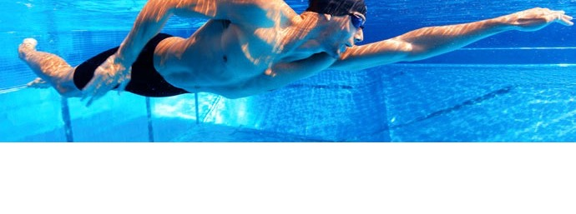
Video: Freestyle Stroke
https://www.youtube.com/watch?v=0_VM8z9KZQ8&index=5&list=PLqeVqsXqy39hW9UhrsA3nCm3r55bLLcxk

Slide 54
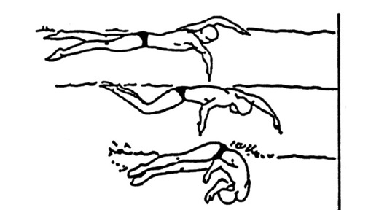
Freestyle Turn
Did the swimmer touch the wall? If they missed touching, they can return to touch with no DQ; same for the freestyle relay if they left early.

Slide 55
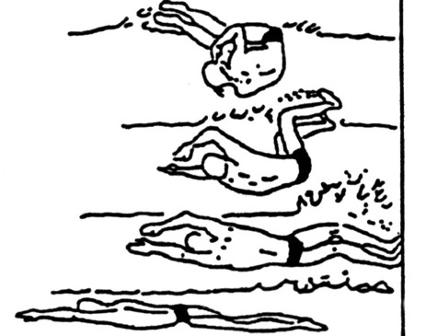
Freestyle Turn
Did the swimmer touch the wall?

Slide 56
Video: Officiating Freestyle
https://www.youtube.com/watch?v=baQJzcnG3oQ&list=PLJUznzZd1j8Urx4pxOW9gYFCzrWMb0jgx&index=4

Slide 57
Freestyle – DQ Wording
The following is the suggested, but not the only wording for disqualifications (write more rather than less):
  “Failure to touch on the turn at 25m (50m, 75m)”
  “Failure to surface by 15m after the start (or turn at 25m, 50m, 75m) in the freestyle.”

Slide 58
Backstroke
Any stroke or combination may be used as long as it is swum on the back.
Following the start and after the turn, the head must break the surface before the 15 metre mark.
They must finish on their back (including the backstroke portion of the relays).

Slide 59
Backstroke
The normal position on the back can include a roll movement of the body up to, but not past 90 degrees from horizontal as determined by the line of the shoulders.

Slide 60
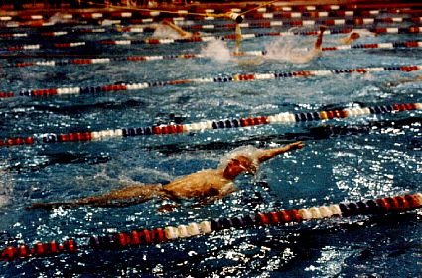
Backstroke
Rolling beyond the vertical (Infraction during stroke, but permitted on the turn.)

Slide 61
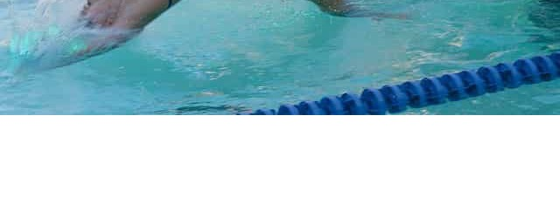
Video Backstroke Stroke
https://www.youtube.com/watch?v=6ZXUEfP-Agc&list=PLJUznzZd1j8Urx4pxOW9gYFCzrWMb0jgx&index=5

Slide 62
Backstroke Turn
Executing a turn is a continuous motion, meaning a uniform, unbroken motion with no pauses.
After the upper shoulder rotates beyond the vertical toward the breast, a continuous single arm pull or a continuous double arm pull may be used to execute the turn – not two separate arm pulls.
A swimmer can scull back to the wall to complete the turn if the wall is missed.
Attention must be focused on the upper body of the swimmer.
Some part of body must break the surface at turn and finish.

Slide 63
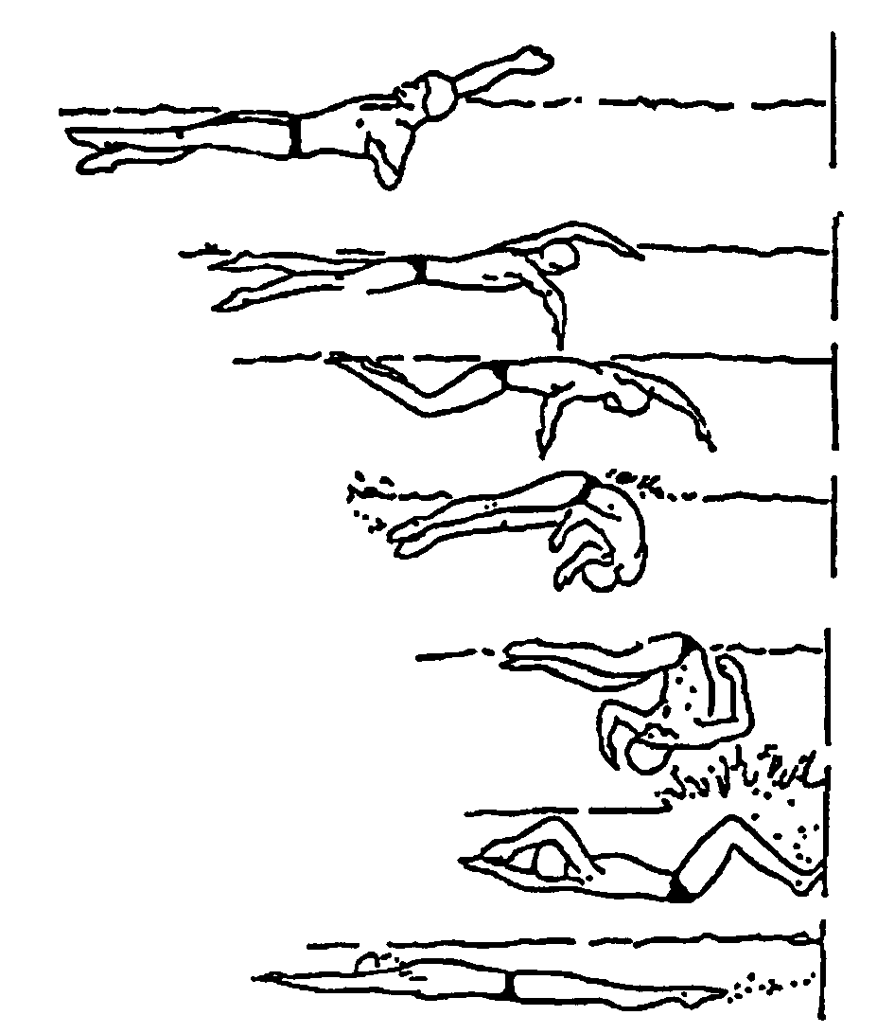
Backstroke Turn

Slide 64
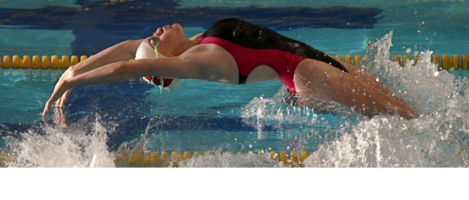
Video: officiating backstroke
https://www.youtube.com/watch?v=PxtMNaK4kME&index=3&list=PLqeVqsXqy39hW9UhrsA3nCm3r55bLLcxk

Slide 65
Backstroke – DQ Wording
The following is the suggested, but not the only wording for disqualifications:
  “failure to touch on the turn at 25m (50m, 75m)”
  “swimming on front before the turn at 25m (50m, 75m).”
  “failure to remain on back during race (or at finish)”
  “failure to surface by 15 m after the start (or turn at 25m, 50m, 75m) in the backstroke”
  “not on back when feet left the wall at 25m (50m, 75m)”
  “failure to break surface of the water at 25m turn (50m, 75m)”

Slide 66
Butterfly
No more than one arm stroke when submerged and the body must be on the breast.
Arm movement must be simultaneous.
There is no limit to the number of legal kicks.
Legs must not alternate with each other, but can be offset.
Kick may be dolphin or breaststroke (not scissor) and may change back and forth without penalty.
Must break the surface before 15m on start and turns.

Slide 67

Video: Butterfly stroke
https://www.youtube.com/watch?v=4ajQQQnSKQ0&list=PLJUznzZd1j8Urx4pxOW9gYFCzrWMb0jgx&index=6

Slide 68
Butterfly - Turn
Must not recover arms under the water to touch.
Touch must be with both hands simultaneously.
Hands cannot be stacked one on top of the other (Thumbs touch or overlapping of fingers only okay).
Underwater kicking on the side is allowed BEFORE the first arm pull.

Slide 69
Video: Officiating Butterfly
https://www.youtube.com/watch?v=74N6n5HwbTo&index=2&list=PLqeVqsXqy39hW9UhrsA3nCm3r55bLLcxk

Slide 70
Butterfly – DQ Wording
The following is the preferred, but not only wording for disqualifications:
  “non-simultaneous touch at 25m (50m, finish)”
  “non-simultaneous touch at 25m (50m, finish) with one hand on top of the other
  “one hand touch at 25m (50m, 75m, finish)”
  “Flutter kick”
  “Scissor kick”
  “Underwater arm recovery”
  “Non-simultaneous arm pull”
  “Failure to surface by 15m after the start (or turn at 25m, 50m, 75m) in the butterfly”

Slide 71
Breaststroke
Each cycle must have one arm stroke, one leg kick and the head must break the surface of the water.
The body must be kept on the breast.
Arm movements must be simultaneous and in the same horizontal place and must not extended beyond the hips.
Leg movements must be simultaneous and in the same horizontal place.
The toes must not turn inward in the backward movement of the kick (or it is a scissor kick).

Slide 72

Video: Breaststroke Stroke
https://www.youtube.com/watch?v=BkbvAOwt7oM&index=4&list=PLqeVqsXqy39hW9UhrsA3nCm3r55bLLcxk

Slide 73
Breaststroke Turn
Jurisdiction: From the beginning of the last arm stroke “in” to the completion of the second arm pull “out”.
Must touch with both hands simultaneously (does not have to be at the same level).
Hands cannot be stacked one on top of the other (Thumbs touch or overlapping of fingers only okay).
May turn in any manner as long as the prescribed from is attained before the start of the first arm pull.
From the beginning of the first armstroke after the start and after each turn, the body shall be kept on the breast.

Slide 74
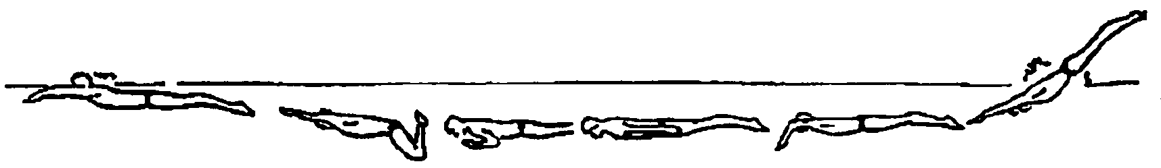
Breaststroke Start (and Turn)
The hands may extend beyond the hips during the first stroke after the start and each turn; such extension at any other time is a DQ.
A single dolphin kick is allowed at the start and after each turn at anytime prior to the whipkick.

Slide 75
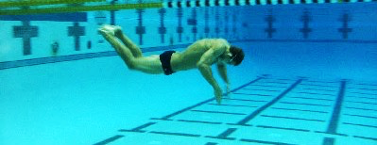
Video: Officiating Breaststroke
https://www.youtube.com/watch?v=6ZXUEfP-Agc&list=PLJUznzZd1j8Urx4pxOW9gYFCzrWMb0jgx&index=5

Slide 76
Breaststroke – DQ Wording
The following is the preferred, but not only wording for DQs:
  “non-simultaneous touch at 25m (50m, finish)”
  “non-simultaneous touch at 25m (50m, finish) with one hand on top of the other
  “one hand touch as 25m (50m, 75m, finish)”
  “scissor kick”
  “asymmetric arm pull”
  “more than 1 dolphin kick at start (or turn at xx metres)”

Slide 77
Breaststroke – DQ Wording (cont.)
  “alternating arm movements”
  “arm pull past hips – other than at start or turn”
  “failure of head to surface during each stroke” – except first stroke at start and turn.
  “failure of head to surface before the hands turn inward at the widest part of the second stroke on start (or turn at 25m, 50m, 75m)”

Slide 78
Medley Races
INDIVIDUAL MEDLEY
Butterfly (Fly)
Backstroke (Back)
Breaststroke (Breast)
Freestyle (Free)
FBBF!
MEDLEY RELAY
Backstroke (Back)
Breaststroke (Breast)
Butterfly (Fly)
Freestyle (Free)
BBFF!
Individual
Relay
Note: In medley races, “freestyle” should be some form of front crawl. Swimmers may scull on their backs but are not permitted a full backstroke arm pull; backstroke flip turn not permitted when changing to breaststroke on IM, suicide turn okay.

Slide 79
Relays
Swimmers must abide by the rules of the individual stroke concerned.
When changing from one stroke leg to the next, swimmers may turn in any manner once a legal touch has been made, but they must attain the form of the stroke of the next leg of the race in accordance with the rule for that stroke.
During the Backstroke phase, the final touch must be made while on the back

Slide 80
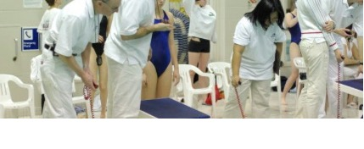
Video: Officiating Relays
https://www.youtube.com/watch?v=BV2dAE0VXTE&list=PLJUznzZd1j8Urx4pxOW9gYFCzrWMb0jgx&index=2

Slide 81
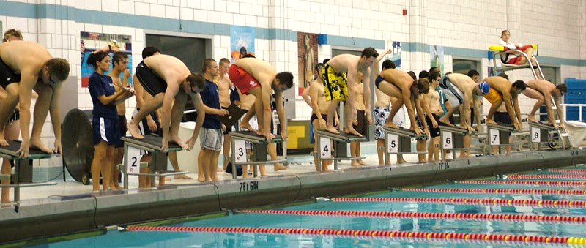
Video: Officiating IM
https://www.youtube.com/watch?v=6w452d_ZcAA&list=PLJUznzZd1j8Urx4pxOW9gYFCzrWMb0jgx&index=3

Slide 82
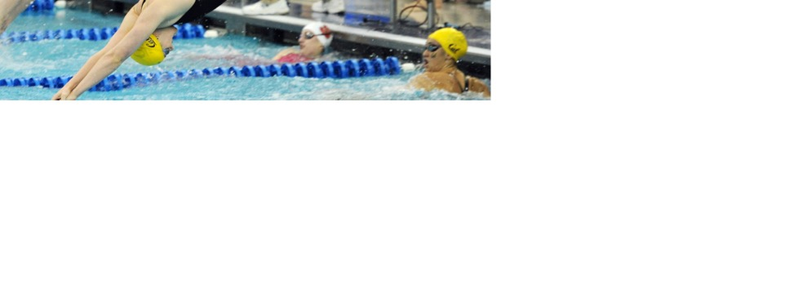
Video: IM and Medley Relays
https://www.youtube.com/watch?v=H3mSU2AHRco&index=7&list=PLqeVqsXqy39hW9UhrsA3nCm3r55bLLcxk

Slide 83
Relays/IM – DQ Wording
The following is the preferred but not only wording for disqualifications (write more rather than less):
“strokes swum in wrong order”
“roll more than 90 degrees before touching on the change over from back to breast” – only applies to IM
“swimmer # ___ left the blocks before swimmer # ___ touched” – only applies to relays
Note that swimmers can return without penalty, touch and start again if they left early – for both freestyle and medley relays

Slide 84
Disqualifications

Slide 85
Disqualifications
Don’t be Obvious
Stroke
Judge
Starter
Turn
Judge
Turn
Judge
Turn
Judge
Stroke
Judge
Referee

Slide 86
Disqualifications
Inform the Referee / Starter
Stroke
Judge
Starter
Turn
Judge
Turn
Judge
Turn
Judge
Stroke
Judge
Referee

Slide 87
Disqualifications
15 min.
Head Coach of DQ’d Swimmer’s Team
Stroke
Judge
Starter
Turn
Judge
Turn
Judge
Turn
Judge
DDO
Referee

Slide 88
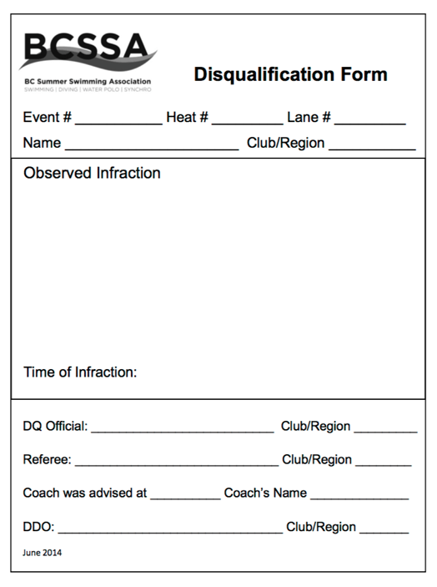
WHI
RIC
CLO
SUR
NOD
LAD
BOU
CRB
use common wording
- see sheet on clipboard
write `what you observed

Slide 89
Process for Disqualifications
When infraction occurs within your jurisdiction, note on your heat sheet.
Don’t leave your position early or otherwise signal a DQ.
Advise Ref/Starter, which swimmer is being DQ’d and for what reason.
After Referee has signed off the DQ, Designated Disqualification Official (DDO) will advise the coach of the DQ’d swimmer and for what reason.

Slide 90
Process for Disqualifications
After Referee has signed off the DQ, Designated Disqualification Official (DDO) will advise the coach of the DQ’d swimmer and for what reason.
Take your time to explain the reason for the DQ to the referee. Don’t feel rushed or mistakes could be made.

Slide 91
Disqualifications
Be consistent in all competitions
Treat all competitors alike
Watch for infractions of the rules whether they give an advantage or not
Never coach or warn a swimmer
Make your presence felt, but not obvious
Be sure you saw what you think you saw
NO DQ’s for 25m events (6 & Under)

Slide 92
Disqualifications
Be prepared to explain your observation to the Referee/Starter or to a Jury of Appeal.
If you make a mistake, its ok. Its part of the learning experience.
Never argue about a DQ with a swimmer, coach, or parent. Refer them to the Ref.
Don’t be afraid to ask the opinion of another senior official.

Slide 93
All Strokes - Allowed
Standing on the bottom.
Resting on the float lines / side of pool.
Surfacing in the wrong lane (there must be no interference and must finish in the proper lane).
During the turn, from the touch until the swimmer leaves the wall is a “free zone”, (e.g.: goggles can be adjusted w/o DQ.)
Disabled swimmer deviations per Referee (no advantage over other swimmers).

Slide 94
All Strokes – Not Allowed
Leaving the water before completing the distance (DNF, not a DQ).
Walking in the desired direction along the bottom.
Springing from the bottom, if it impacts movement in the desired direction.
Pulling in the desired direction on float lines or the side of the pool.

Slide 95
All Strokes – DQ Wording
The following is the preferred, but not only wording for DQ’s (write more rather than less):
  “Walking on bottom toward finish”
  “Pulling on the lane rope in the direction of the finish”
  “Springing from the bottom toward the finish”

Slide 96
Resources for Officials

Slide 97
Resources for Officials
BCSSA Rule Book – no charge
BCSSA Name Badge – no charge
Officials Pins – awarded by club and region
  request from WRASA
  email Director of Officials
  Officials@WRASA.ca
WRASA Officials Shirt - $29
  request from WRASA
  email Treasurer
  Treasurer@WRASA.ca

Slide 98
Resources for Officials
WRASA Officials Page
  check www.WRASA.ca/officials
Officials’ Meetings at Meets
  start between 6:00 and 7:15 Sat and Sun mornings
Shift Sign up for Officials
  online sign up through Google doc
  usually emailed a week before the meet
  check www.WRASA.ca/officials

Slide 99
Resources for Officials
BCSSA Officials Page
  check www.BCSummerSwimming.com/officials
Fraser South Regional Director of Officials
  Zoe Stronge, Richmond Kigoos
More videos
  Robert Kane Videos
  https://www.youtube.com/playlist?list=PLqeVqsXqy39hW9UhrsA3nCm3r55bLLcxk
  USA Swimming Videos
  https://www.youtube.com/playlist?list=PLJUznzZd1j8Urx4pxOW9gYFCzrWMb0jgx

